Slide 1
Data science in R

Slide 2
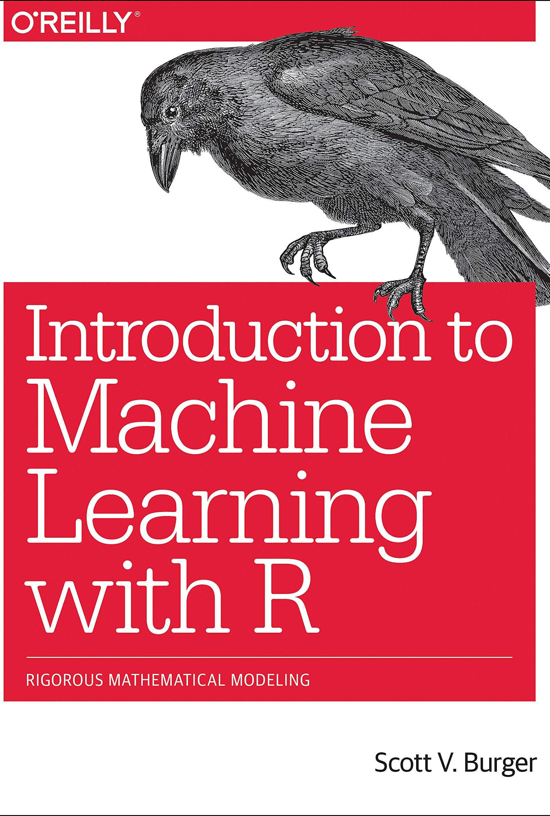
Machine learning
Very common asked for skill in data science jobs
Behind the predictive text, social media feeds, and Netflix suggestions
Very basically uses a learning dataset to try and understand how decisions follow each other. From this, can then model parts of the decision making process given incomplete data (which Netflix program you might want to watch next)

Slide 3
Potential ML functions
Descriptive – system uses data to explain what happened
Predictive – system uses data to predict what will happen
Prescriptive – the system will use the data to make suggestions about what action to take next

Slide 4
Types of ML
Supervised – trained with labelled data sets
Unsupervised – Looks through datasets for patterns without a human influence
Reinforcement – Trial and error learning that “rewards” the algorithm when it makes the correct decision

Slide 5
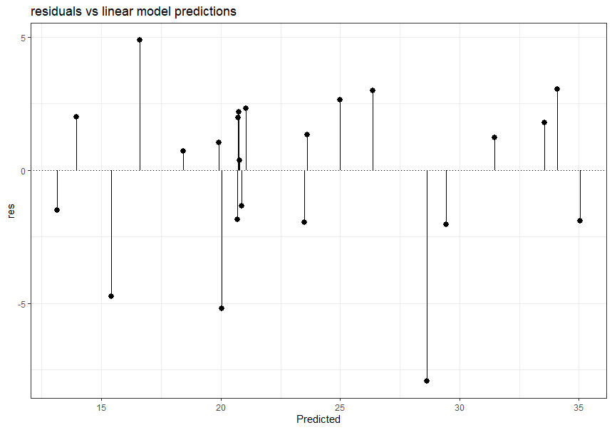
Supervised
Regression (all types) and classification (Decision trees, K-nearest neighbour etc)

Slide 6
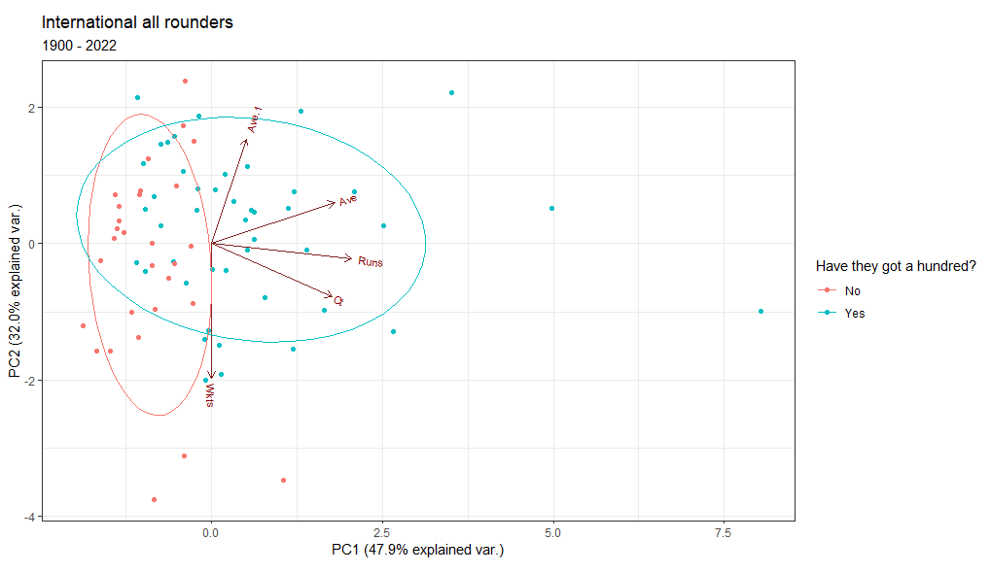
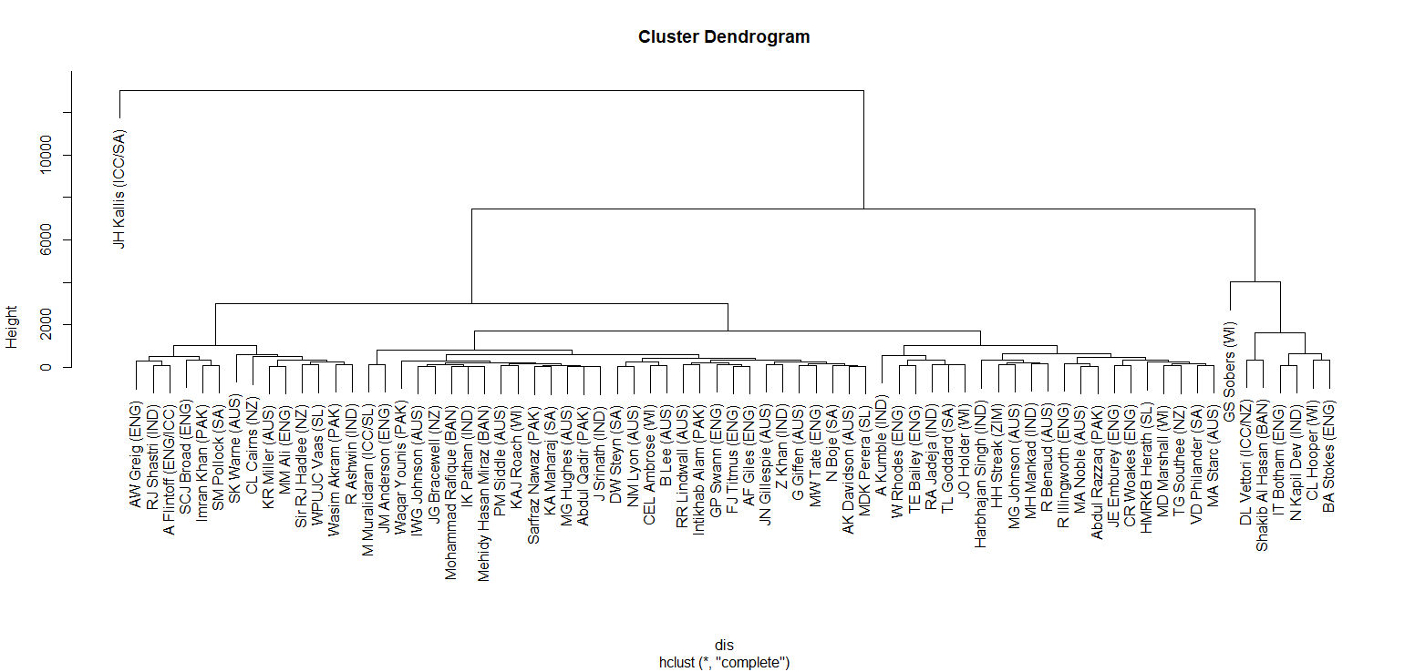
Unsupervised
PCA, K-means and hierarchical clustering

Slide 7
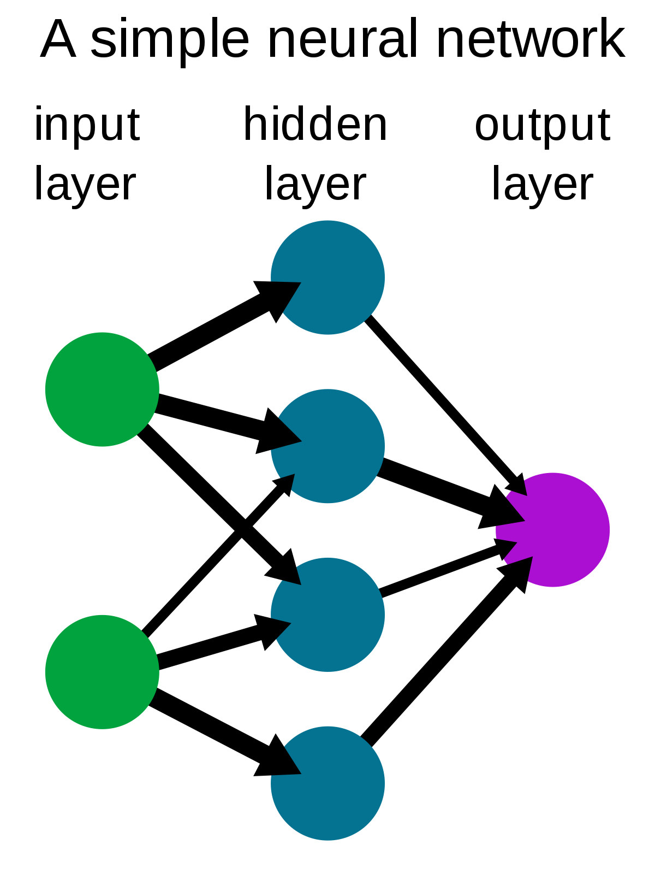
Types of machine learning you might have heard of and their R packages
Natural language processing (Tidytext, Word2Vec, OpenNLP, Spacyr)
Neural networks (neuralnet, nlsr, rminer) 2021-0103-RJournal-SM-AV-CD-PK-JN.pdf (inmodelia.com)
Deep learning (keras)

